Slide 1
On The Spot Courier Service
Web Application System Interface

Slide 2
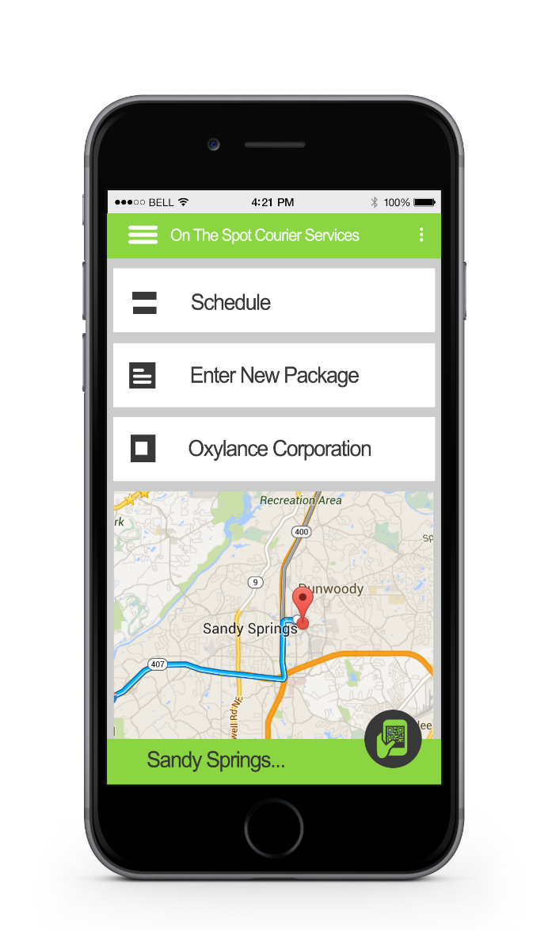
The Driver Interface
The Driver can view and make changes to his Schedule right from the home screen
The Driver can enter new package information
The Web App displays the driver’s next stop We can see that “Oxylance Corporation” is the next stop for this driver
The web App can use Google maps to help the driver find his next stop
The Web App updates the driver’s current location
The Driver can use the QR reader quick button to scan labels and update package information

Slide 3

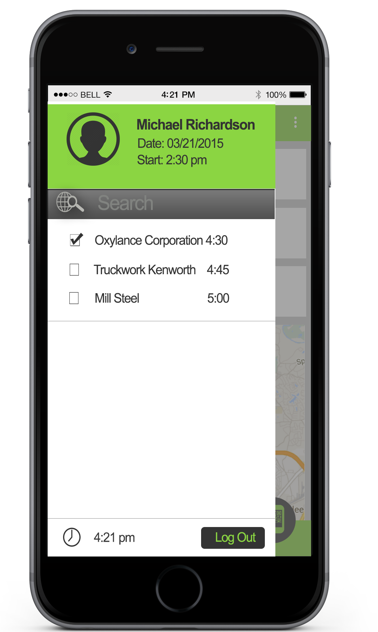
Driver Side bar Menu
The first thing on the side bar menu is the driver's login information. We can see that Michael clocked in at 2:30pm on 20/21/2015
Next we see that the driver has a check list of his secluded stops. Each stop has a checkbox, the name of the company, and the time of the secluded pickup.
At the bottom of the menu we can see the current time and a Log Out button. This button easily lets the driver clock out at the end of his shift.

Slide 4
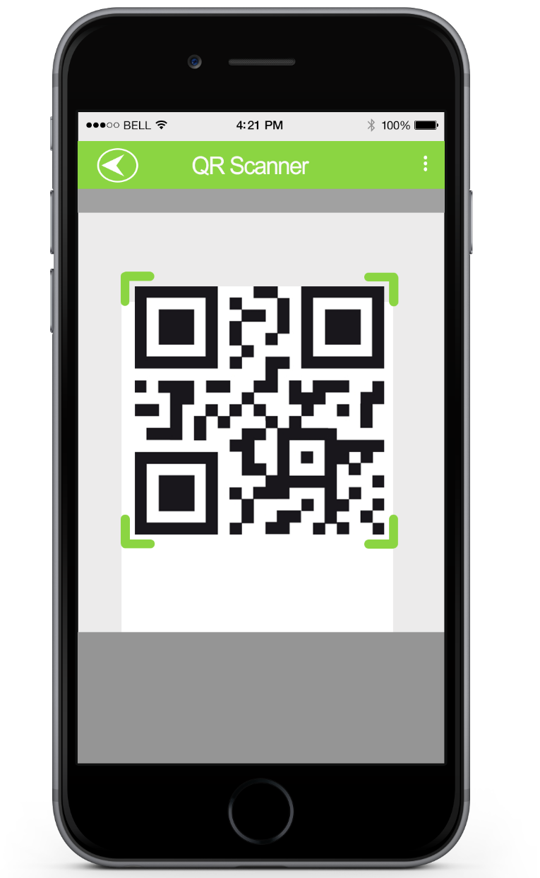
QR Reader
The QR Reader lets the driver scan the packages when he picks then up and drops them off.
All the driver has to do is hold the reader over the QR label and it will automatically scan to code and pull up the package information.
The QR Reader button on the home screen opens up the QR scanner.

Slide 5
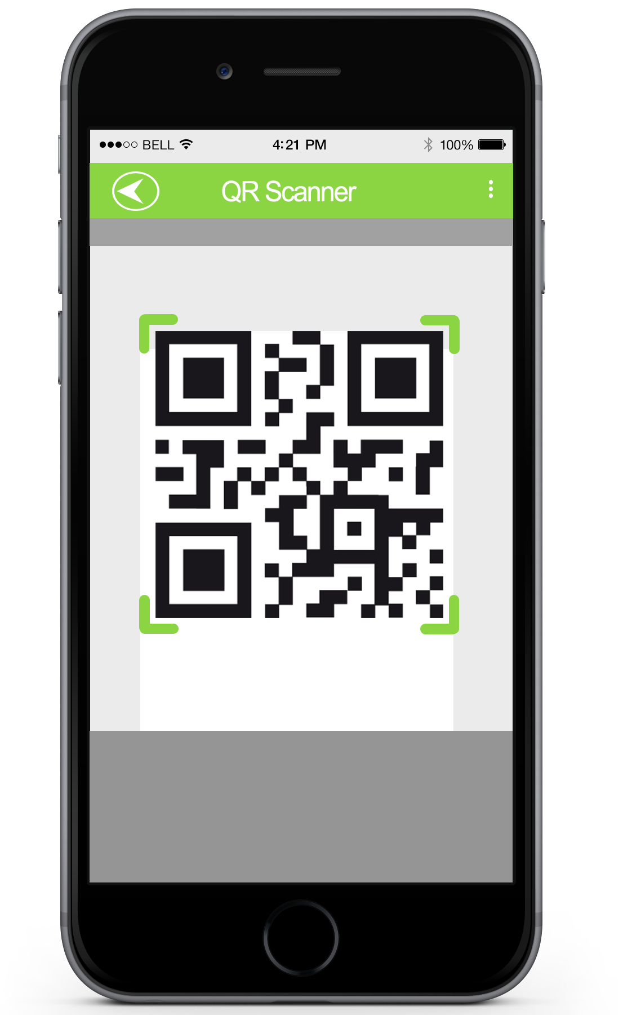
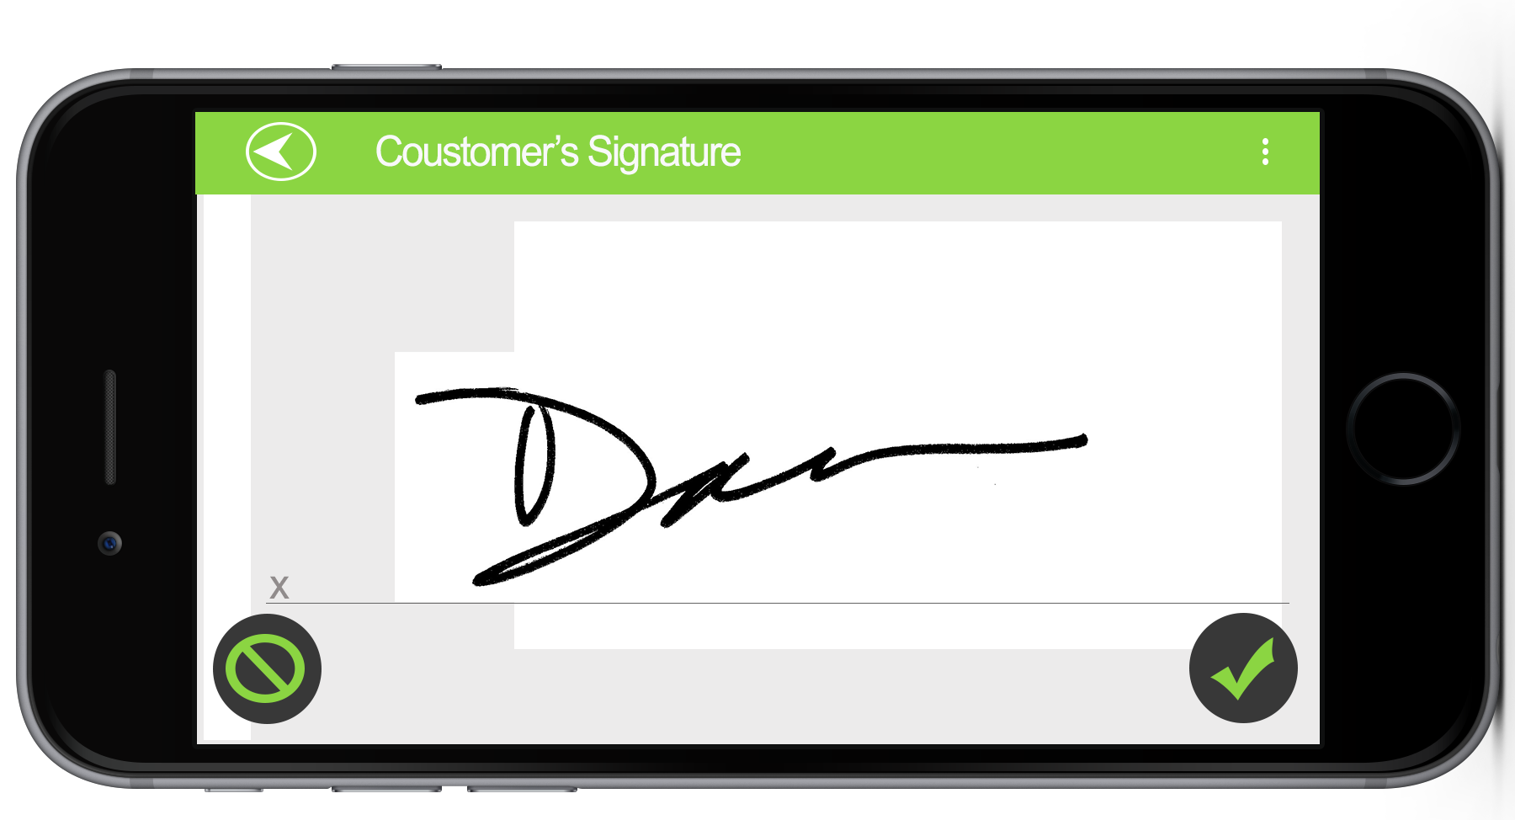
Customer Signature
When the driver delivers a package to a location he scans the package and updates the information.
Then the driver has the Customer sign that the package has been delivered. Now he can do this right from the App.

Slide 6
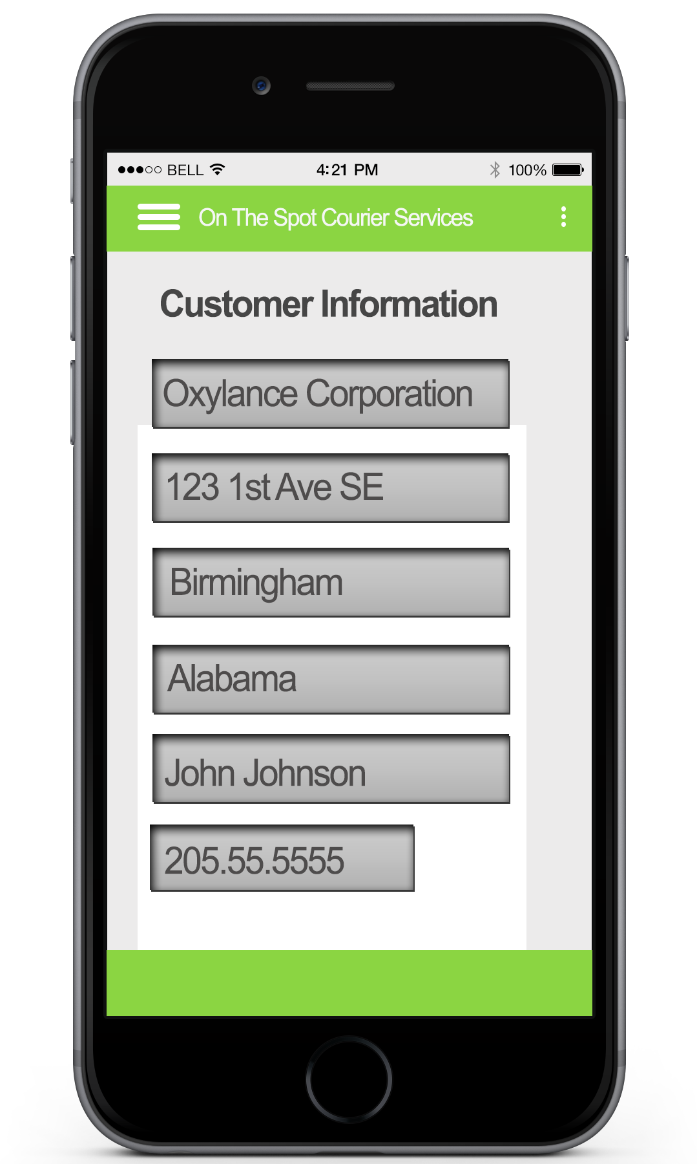
Customer Information
From the Driver’s home screen they can see their next stop. Here we can see it is Oxylance Corporation.
By selecting Oxylance Corporation in the tab the driver can see the customers information

Slide 7

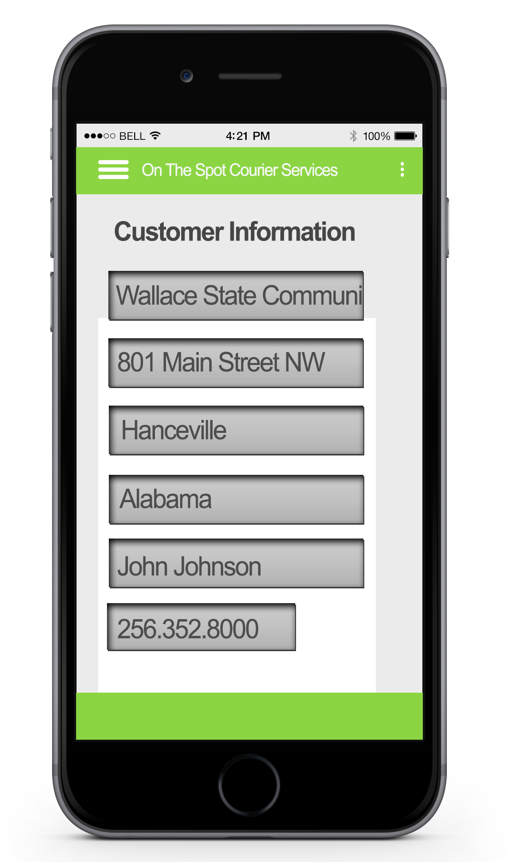
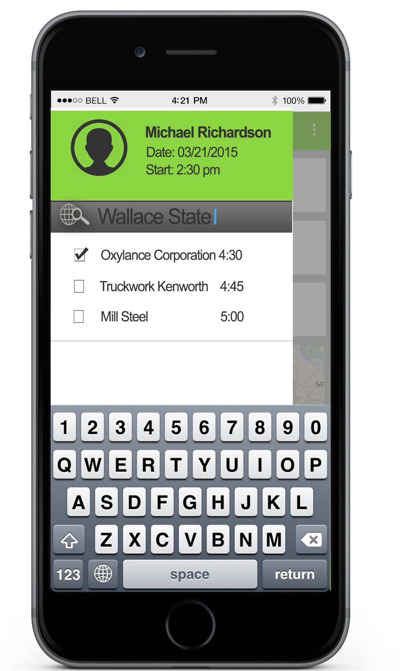
Search For Customer
If you would like to search for a customer you can use the side bar menu
From the Home screen you can open the menu by tapping the menu button (the three lines)
If you don’t see the name of the company in the list you can use the search box
Just type in the name of the company and hit return and it will find them for you.

Slide 8
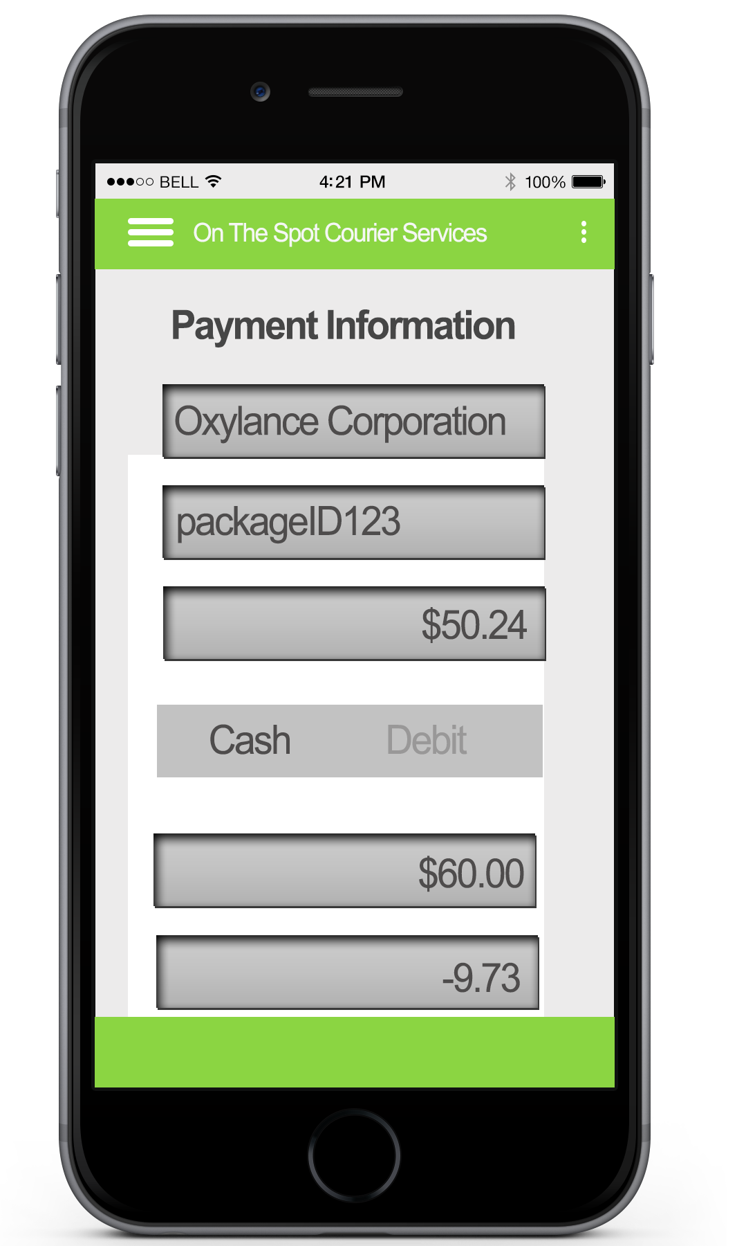
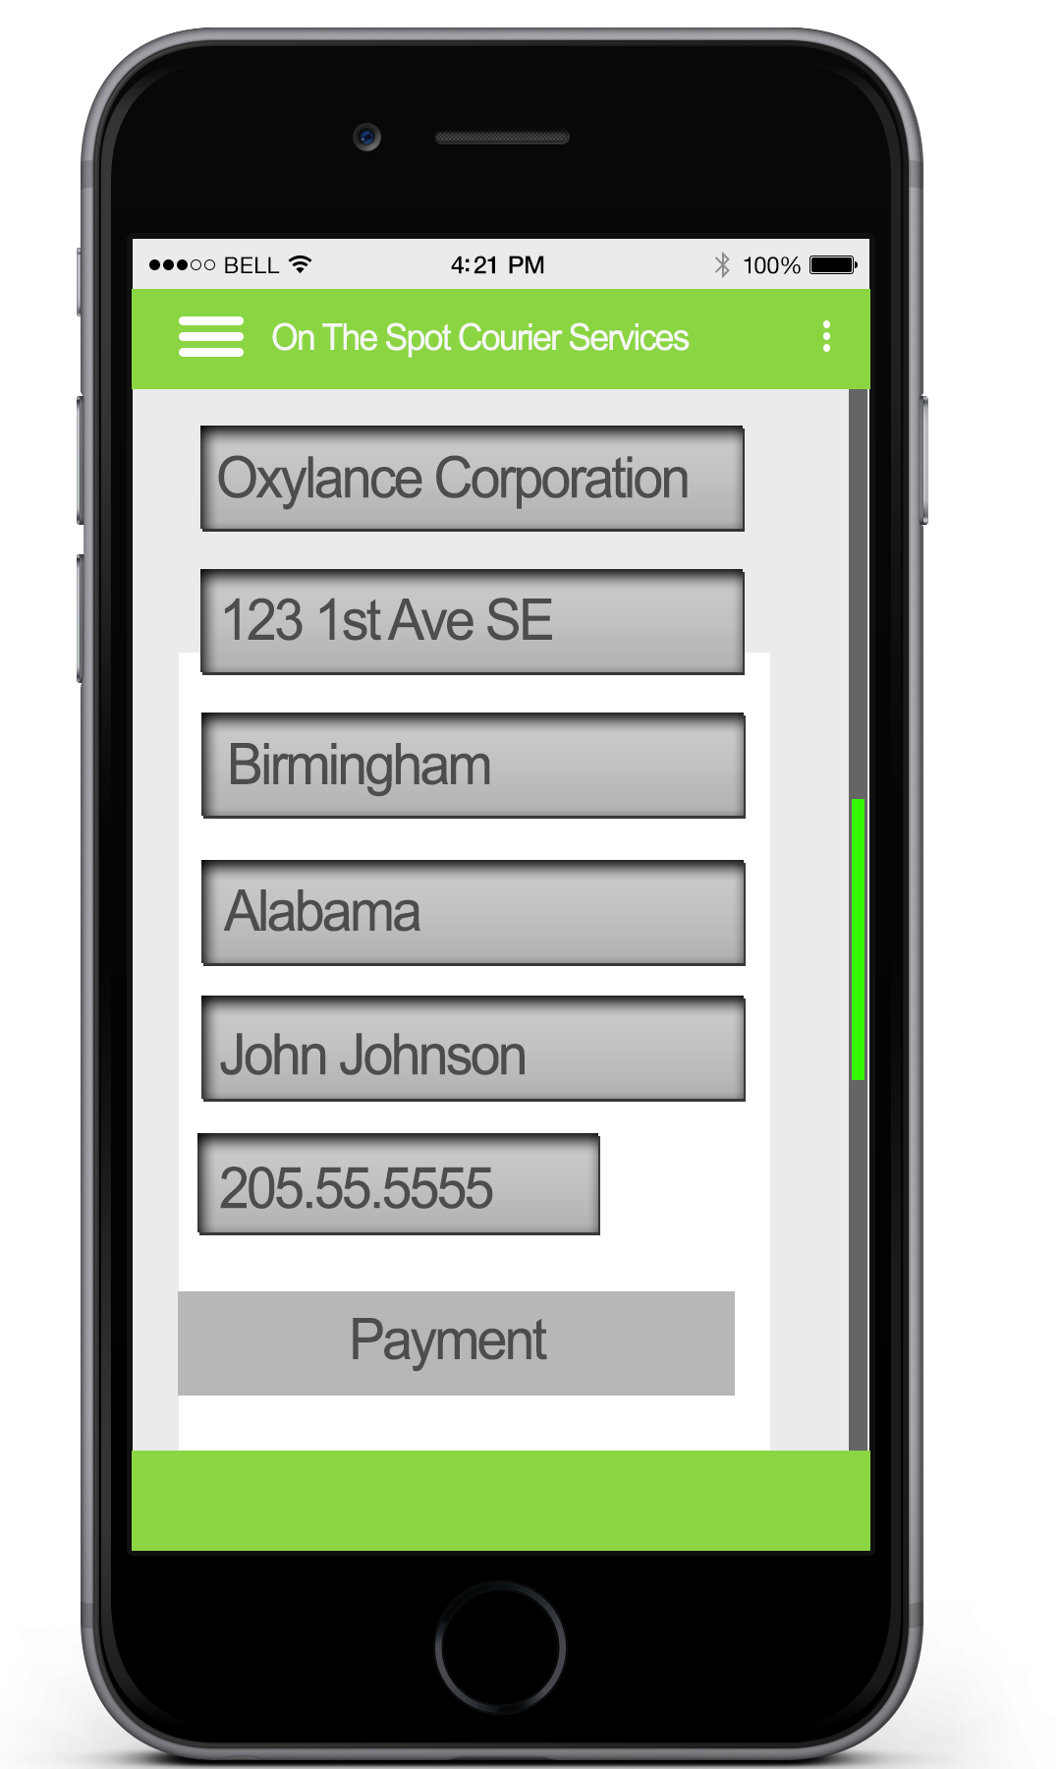
Customer Payment
The Customer
To log a cash payment the driver can scroll down to the payment button
How much the Customer owes
The scroll bar indicates how far the driver has moved down the page
How much the customer paid
Tapping the payment button will bring up the payment screen
The Customer’s change

Slide 9
Thank you for your time

